Slide 1
Federated Multi-Arm Bandit
Project 1 Adaptation by Samuel Gerstein

Slide 2
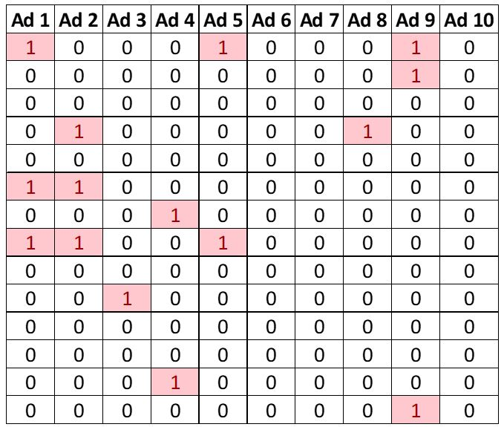
Project 1 Part 2 Review
10000 User Ad Clicks Given
R = 1 for each click
MAB Maximizes User Clicks

Slide 3
What are the drawbacks of the Multi-Arm Bandit in Part 2?
Transmission of Sensitive User Data
MAB can not be scaled for more than one entry at a time
MAB cannot be run locally for devices with poor connectivity

Slide 4
Proposed Federated Bandit Framework
Learning happens solely on the devices, no user data is transmitted
Bandit pulls can run in parallel, easily scalable for large online data
Quicker convergence to the optimal policy

Slide 5
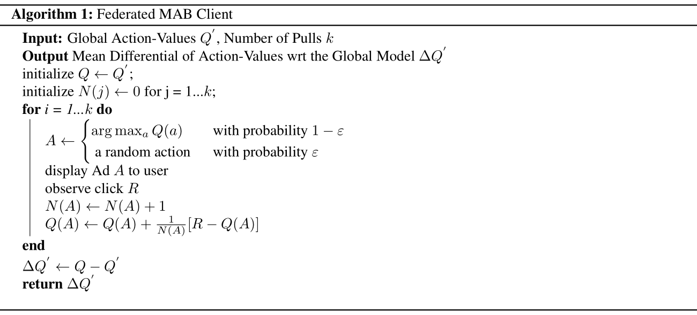
Federated Bandit Client Pseudocode

Slide 6
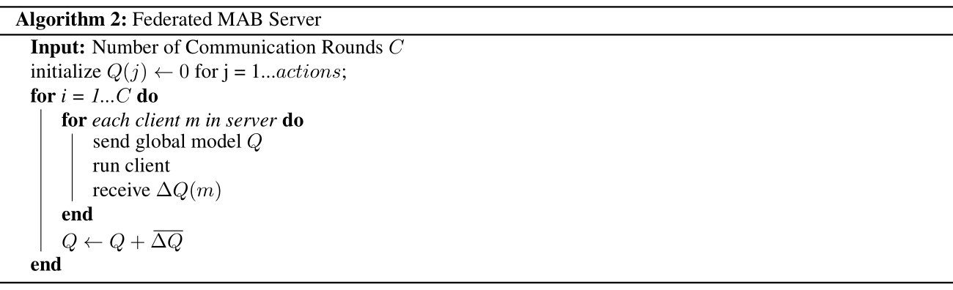
Central Server Pseudocode

Slide 7
Experiment Design
10000 Ad Entries Divided Equally into 100 Clients
10 Communication Rounds
10 Local Pulls

Slide 8
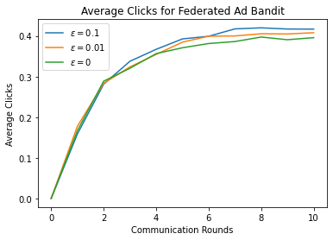
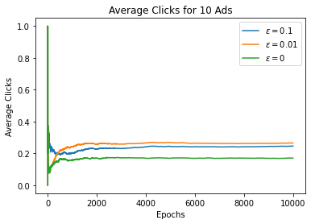
Average Clicks Comparison

Slide 9
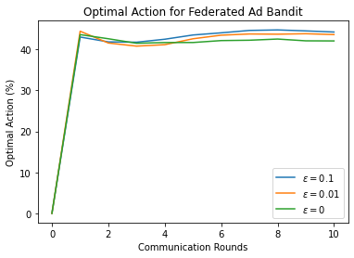
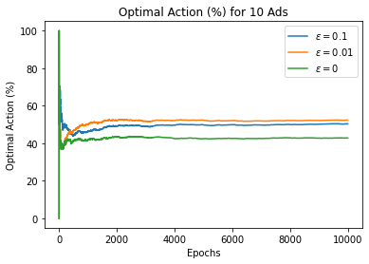
Optimal Action Comparison

Slide 10
Discussion
Modest Increase in Average Clicks
Federated: 0.3 - 0.4
Centralized: 0.15 - 0.3
Decrease in Optimal Action Percentage
Federated: 40 - 60%
Centralized: 40 - 45%
Local Epsilon-Greedy Policy Not as Effective
1-3% Optimal Action Difference between greedy and epsilon-greedy approach
0.05 Average Clicks Difference between greedy and epsilon-greedy approach

Slide 11
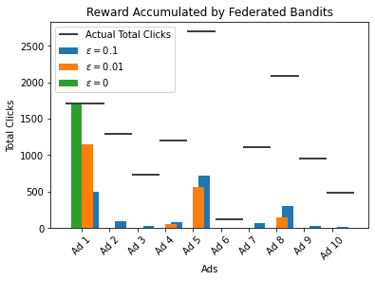
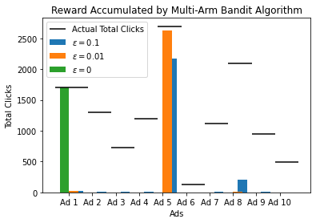
Total Reward Comparison

Slide 12
How to Remedy Federated Exploration Problem
Weigh Exploring Agents Larger
Simple averaging may drown out outliers
Federated Averaging of Gradient-Decay Epsilon
Treat Epsilon as a learned parameter, average in communication rounds
Federated Upper Confidence Bound Algorithm
Learn Upper Interval, average in communication rounds

Slide 13
Conclusion
Explained the issues with centralized MAB
Privacy
Sequential Computing
Long Convergence Time
Proposed Federated MAB Framework
Global model updated with mean differential of local means
Found the drawbacks of local exploration in Federated MAB
Little difference in optimality with greedy policy
Discussed Federated Gradient Epsilon and UCB

